Slide 1
Machine Learning project
Presented by:- Karthik Badiganti

Slide 2
Problem statement
ABC Inc. is a big Multi-National Company wanted to get into power generation industry.
They hired us to know about the market trends and insights about the companies which are already present in the industry.

Slide 3
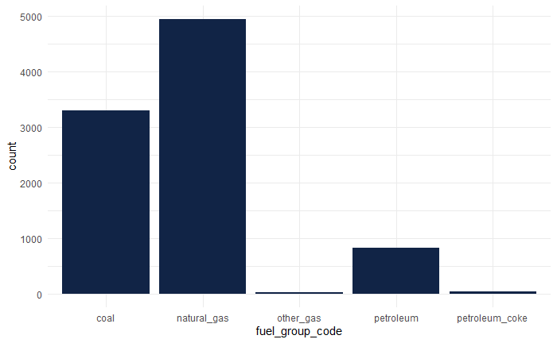
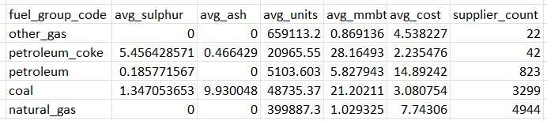
Data Description
Data is extracted from USA energy data spread across years
For analysis, I have taken contents in the fuel along with the costs associated with it
Production of Natural gas and Coal fuel types is more .
People preferring eco-friendly fuels.
Cost for gas is high when compared to coal.

Slide 4
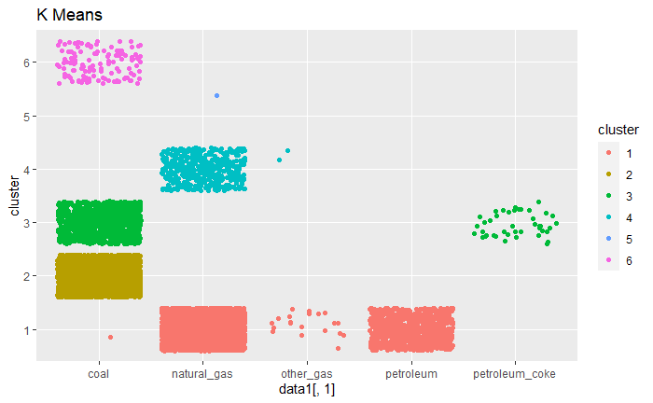
Data analysis
Implemented K-means to cluster and analyze usage and composition
Data divided into 6 clusters based on sulfur content, ash content and fuel units received.
Part of Natural Gas & Petroleum are clustered into one
Coal is further clustered into 3

Slide 5
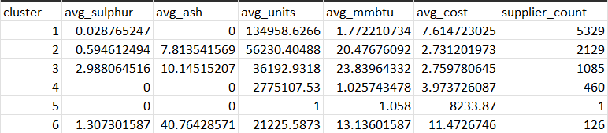
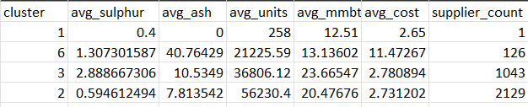
Cluster Analysis Summary
Based on the clusters we can observe that suppliers trying meet the peoples’ preferences by producing energy using less
Clusters 2,3,6 are in the same coal base .
With coal as base for fuel, there is cluster 2 with sulfur and ash content emission within the guidelines of USA.

Slide 6
conclusion
Based on the data and the analysis, we can conclude that,
With cluster 2 we can maintain optimal sulfur and ash content.
Corresponding cost is also less with moderate competition from suppliers.

